Slide 1


ReuNify: A Step Towards Whole Program Analysis for React Native Android Apps
Yonghui Liu ¹, Xiao Chen ¹, Pei Liu, John Grundy ¹, Chunyang Chen ¹, Li Li ²
1 Monash University
2 Beihang University

Slide 2

Background - React Native
Open-Source project introduced by Meta in 2015.
Designed for cross-platform development for iOS and Android.
accelerate app development on multiple platforms.

Slide 3
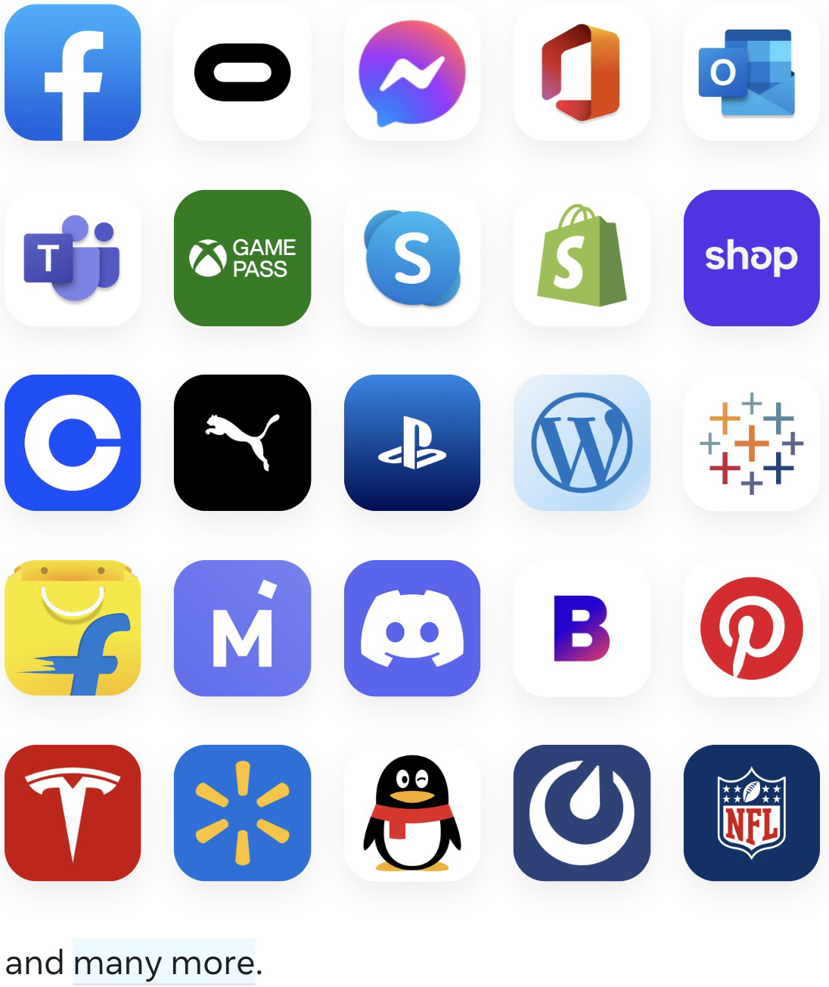
Background - React Native
React Native is the Third most popular framework used in the top 500 US Android Apps after Kotlin and Android Architecture Component
30 of 100 most popular apps in Chinese Android App Store are developed with React Native

Slide 4
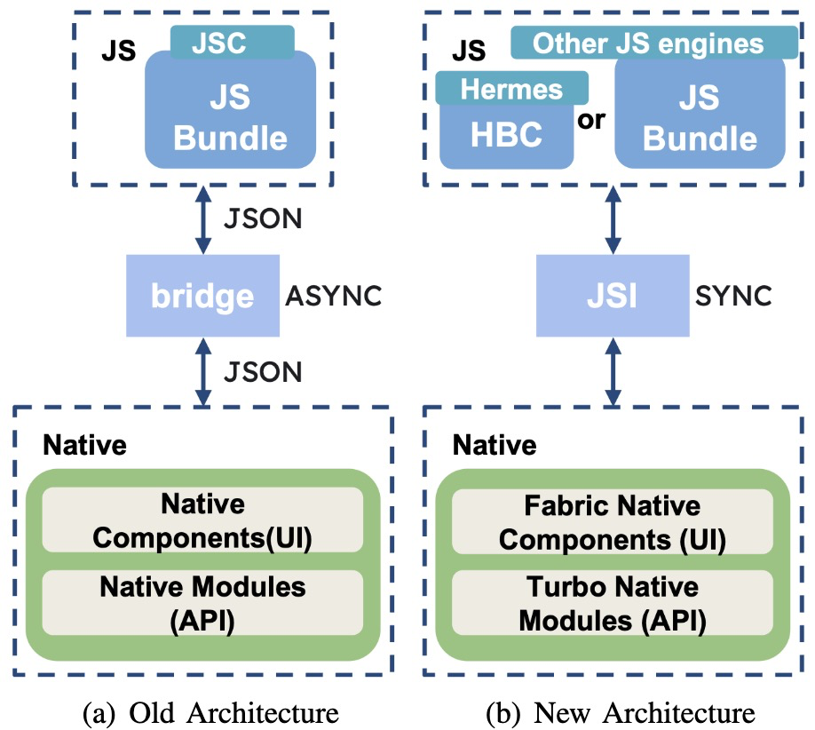
Background - React Native
JavaScript Side
Enables building cross-platform apps with the Single JavaScript Codebase
JavaScript code communicates with the Native code
Object-C/Swift for iOS
Java/Kotlin for Android
Native Side

Slide 5
Background - React Native
JavaScript / Hermes Bytecode
Hermes engine become the optional JS engine, since version 0.60.0 (July, 2019) of React Native
Hermes engine become the default JS engine, since version 0.70 (Sep, 2022)
With Hermes engine, JavaScript code get compiled into hermes bytecode

Slide 6
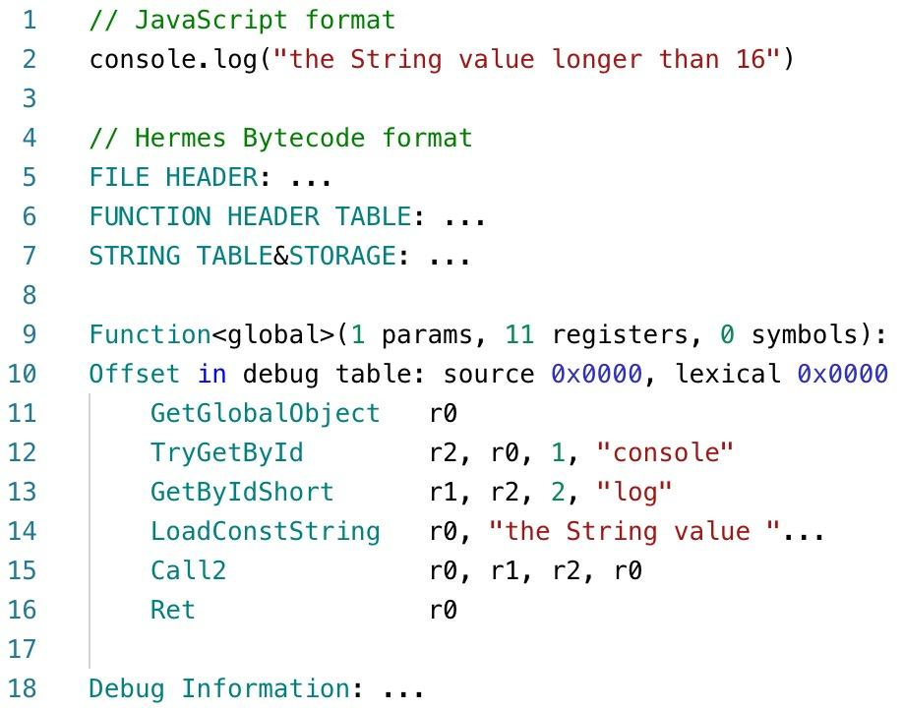
Code Sample 1 - JavaScript code and Hermes bytecode.
r1: callee function
r2, r0: parameter value
r0: store return value
Sankey diagram of all newly detected privacy leaks.

Slide 7
Motivation
Current JavaScript Analyzer are useless in front of Hermes Bytecode.
React Native’s Complex Mechanism impedes the analysis of code on both JavaScript side and Native Side.
Little Research on React Native application.

Slide 8
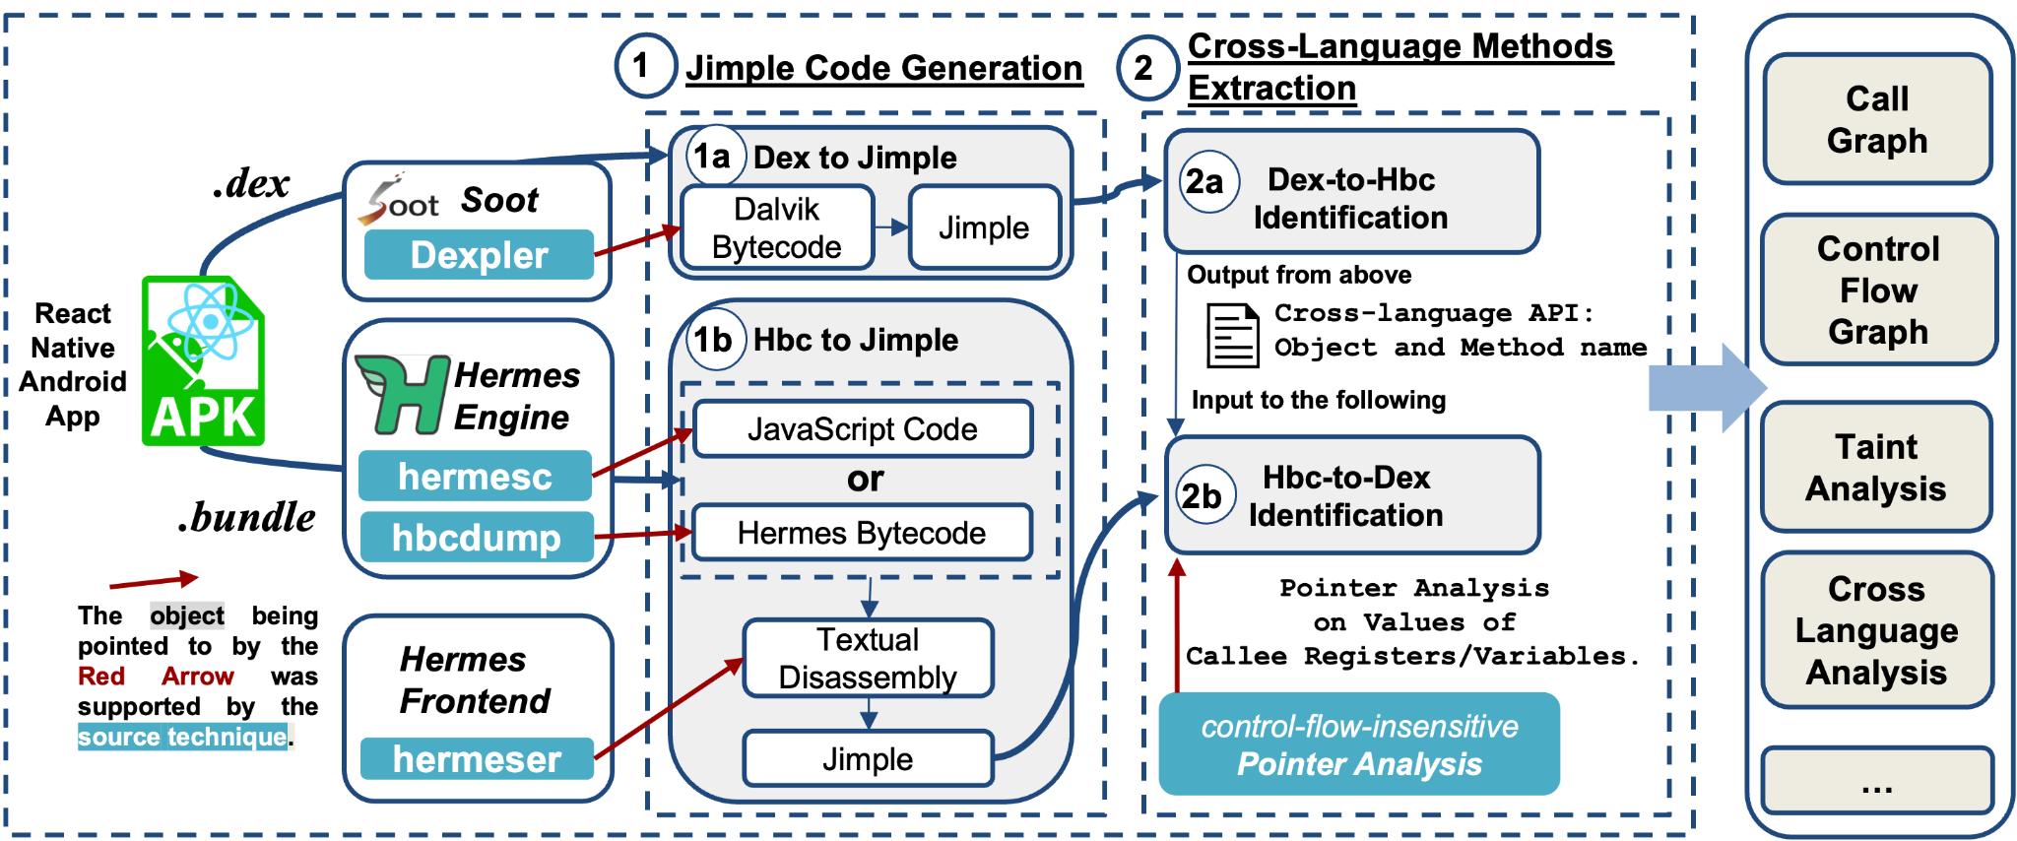
Approach - ReuNify Overview
ReuNify integrates the JavaScript and native-side code of React Native into Jimple.
Jimple is the intermediate representation used in Soot.
Soot is the most popular static analysis framework for Java and Android app.

Slide 9
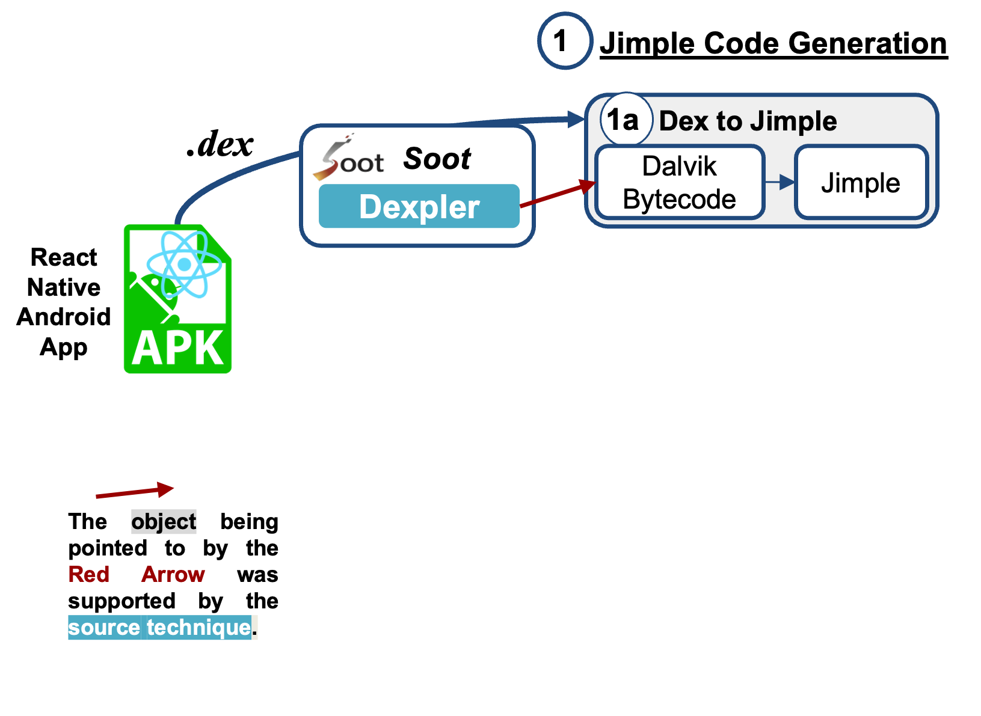
Approach - Jimple Code Generation:
1
Dex to Jimple
Dexpler
Dalvik Bytecode to Jimple (2012, PLDI)
1a

Slide 10
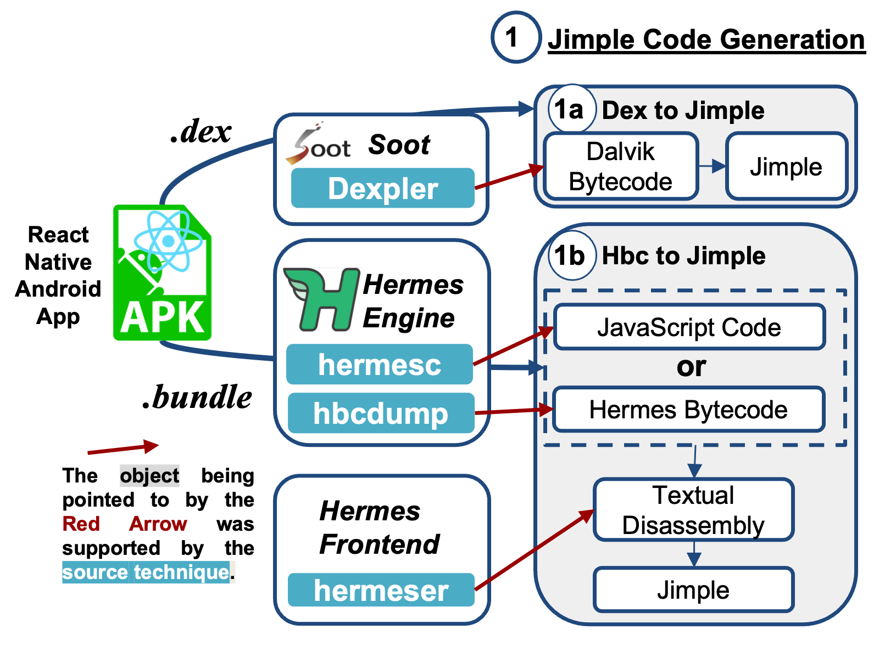
Approach - Jimple Code Generation:
1
Dex to Jimple
Dexpler
Dalvik Bytecode to Jimple (2012, PLDI)
1a
Hbc to Jimple
Hermes Engine
hermesc:Standalone Hermes compiler.
hbcdump: Hermes bytecode disassembler
hermeser
Textual Disassembly to Jimple
1b

Slide 11
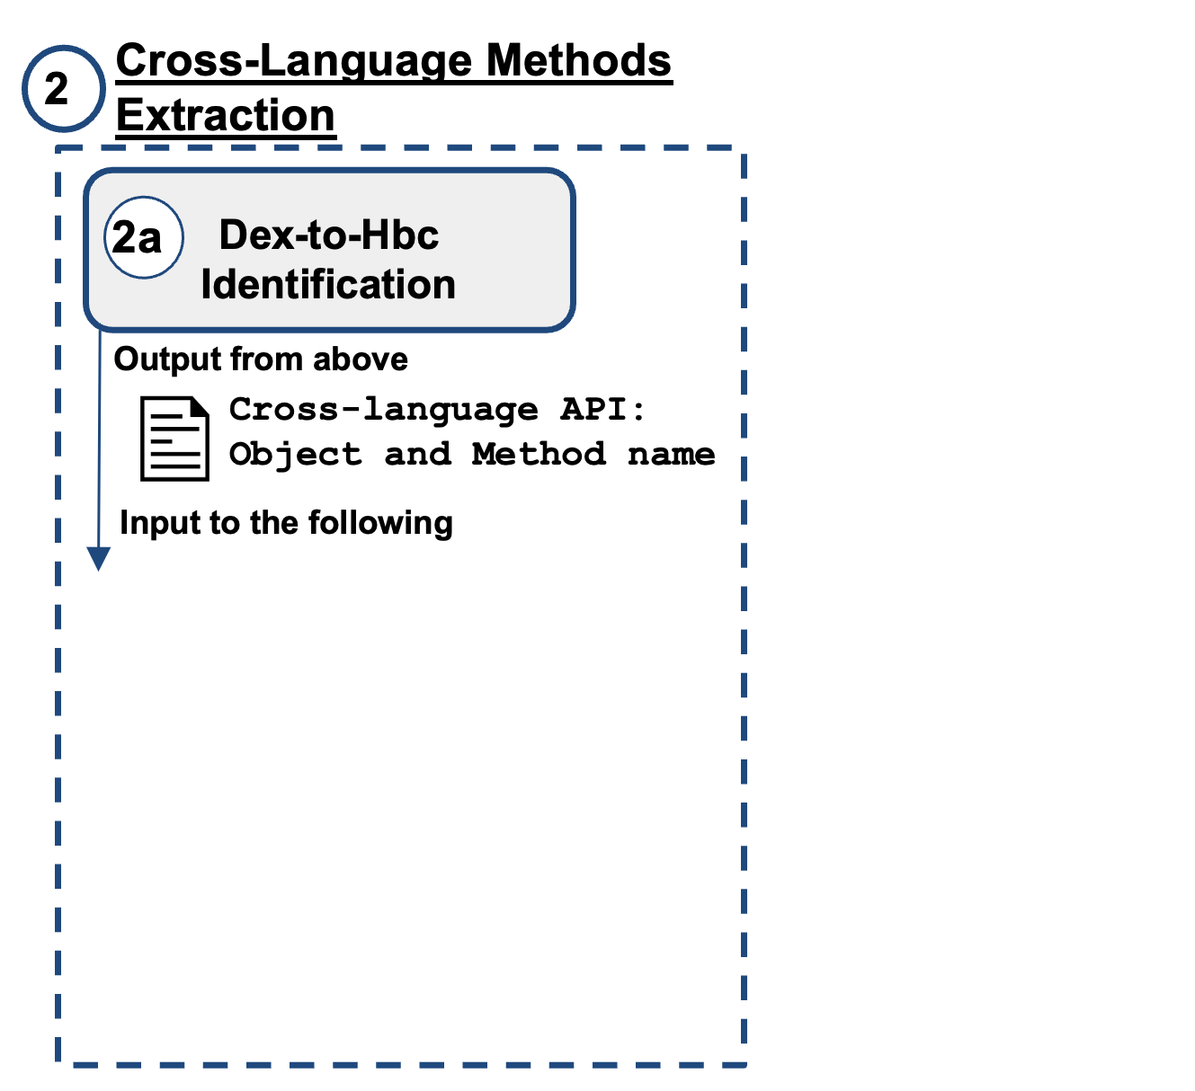

Approach - Cross-Language Methods Extraction:
2
2a
Dex-to-Hbc Identification
Rule-based strategy to locate the native-side functions that are exposed to the JavaScript side by considering the React Native Mechanism
Cross-language API:
Object and Method name

Slide 12
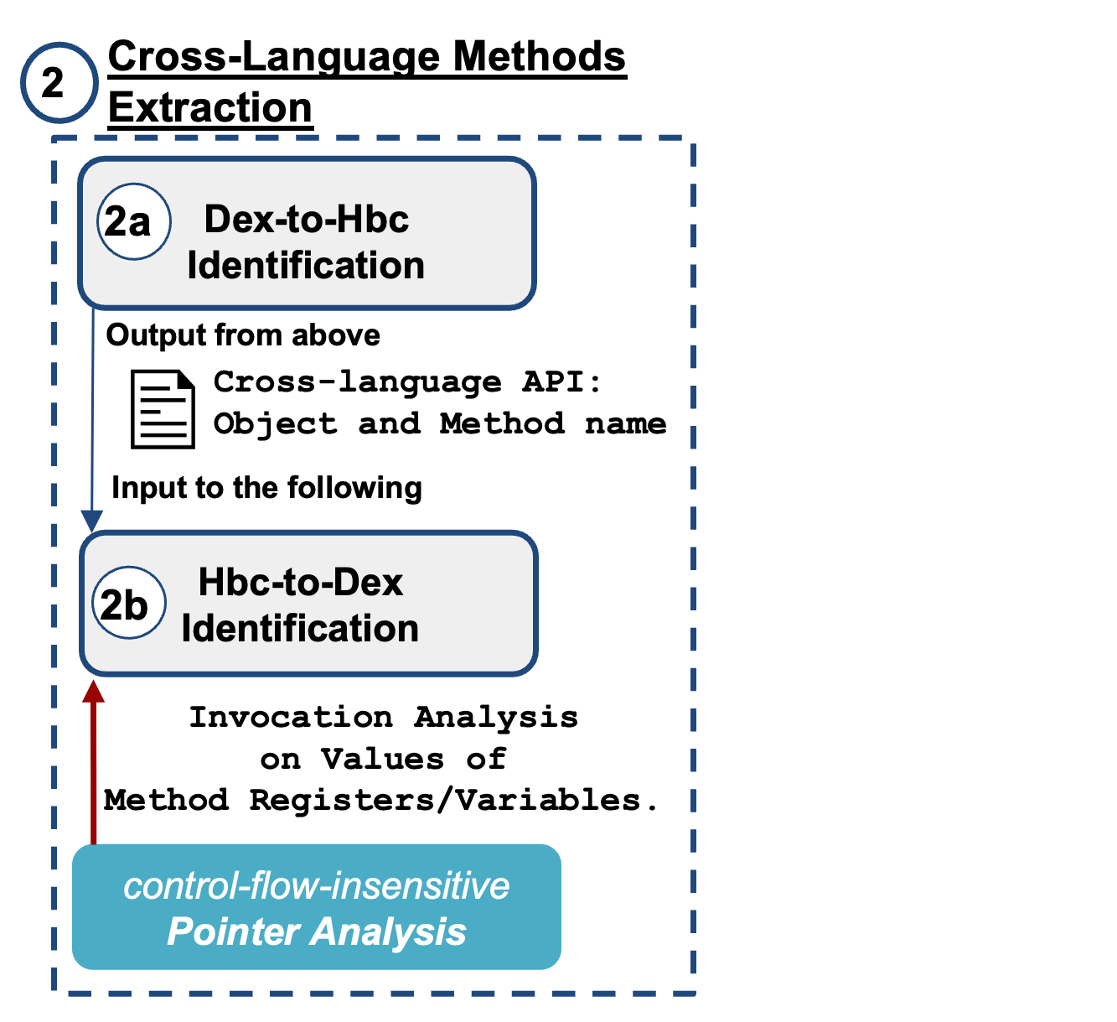
Approach - Cross-Language Methods Extraction:
2
2a
Dex-to-Hbc Identification
Rule-based strategy to locate the native-side functions that are exposed to the JavaScript side by considering the React Native Mechanism
Cross-language API:
Object and Method name
2b
Hbc-to-Dex Identification
Control-flow-insensitive Pointer Analysis
Pointer Analysis on the Invocation

Slide 13
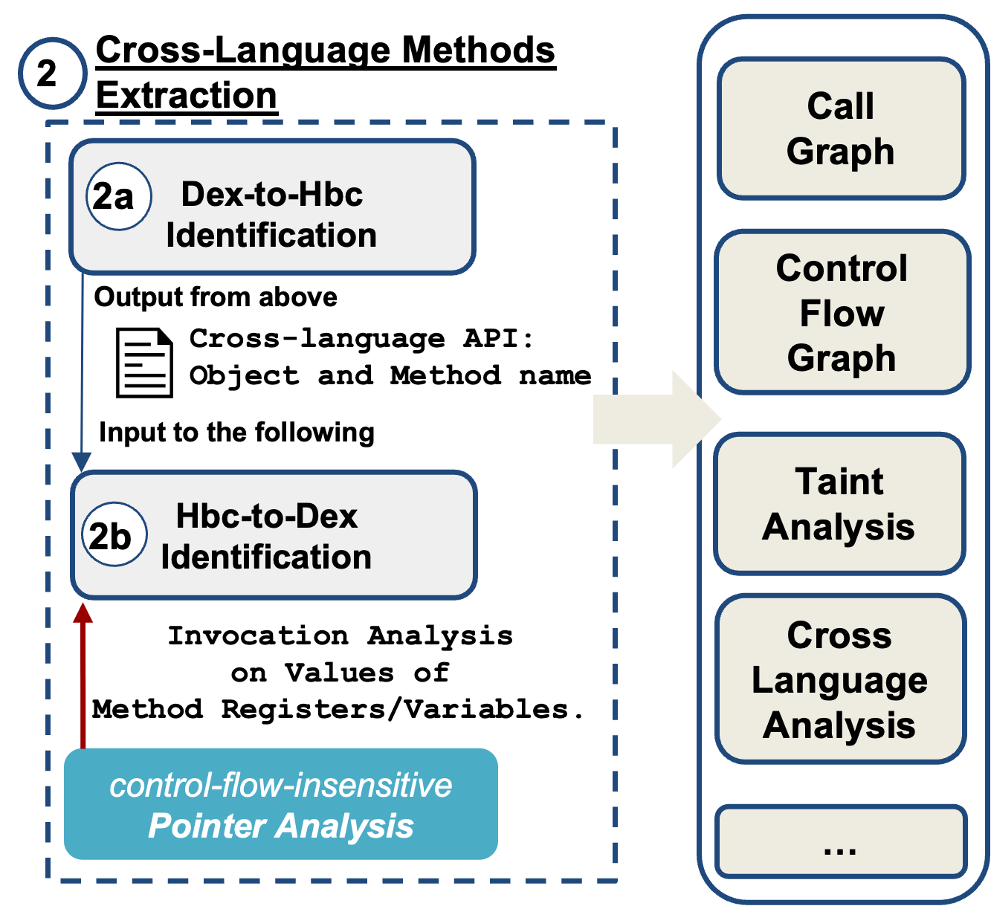
Approach - Cross-Language Methods Extraction:
2
2a
Dex-to-Hbc Identification
Rule-based strategy to locate the native-side functions that are exposed to the JavaScript side by considering the React Native Mechanism
Cross-language API:
Object and Method name
2b
Hbc-to-Dex Identification
Pointer Analysis on the Invocation
Control-flow-insensitive Pointer Analysis
The outcomes of this step enable the execution of complex Analysis on both Java and JavaScript code of the React Native Android App.

Slide 14
Code Sample 1 - JavaScript code and Hermes bytecode.
r1: callee function
r2, r0: parameter value
r0: store return value
Sankey diagram of all newly detected privacy leaks.

Slide 15
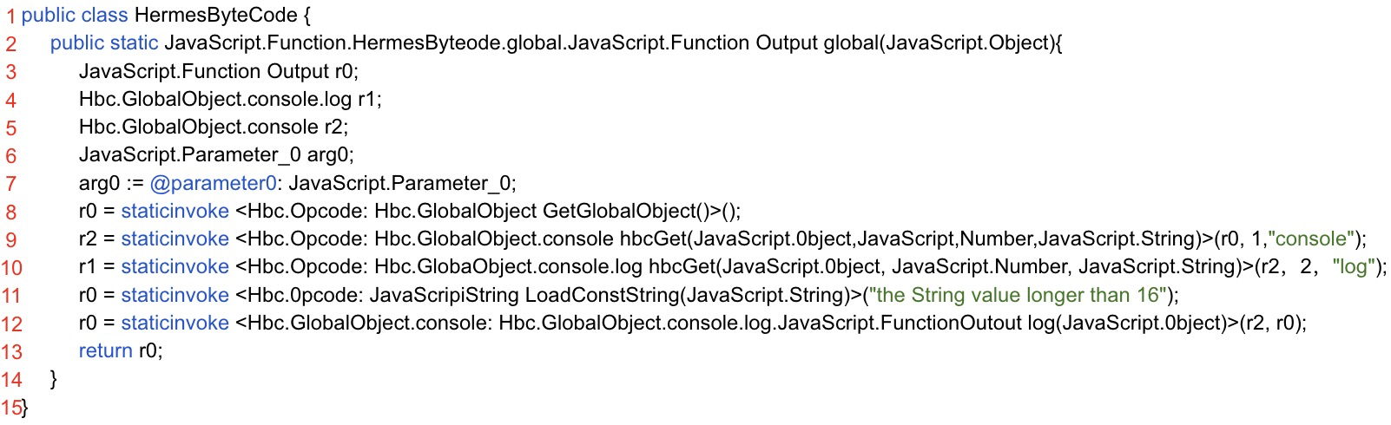
Code Sample 2 - Generated Jimple Code
Class Name: Hbc.GlobalObject.console;
Return Type: Hbc.GlobalObject.console.log.JavaScript.FunctionOutput;
Method Name: log;
Parameter: r2, r0;
Return: r0;
Sankey diagram of all newly detected privacy leaks.

Slide 16
Code Sample 3 - Invocation Statement
JavaScript:
console.log(“the String Value longer than 16”)
Hbc:
Call2 r0, r1, r2, r0
r1: callee function; r2, r0: parameter value; r0: store return value
Jimpe:
staticinvoke
Class Name: Hbc.GlobalObject.console;
Return Type: Hbc.GlobalObject.console.log.JavaScript.FunctionOutput;
Method Name: log;
Parameter: r2, r0;
Return: r0;

Slide 17
Evaluation - Research Questions
RQ1: How well does ReuNify enhance Soot-based static analysis on React Native Android Apps?
RQ2: How effective is ReuNify in finding sensitive data leaks in React Native Android Apps?

Slide 18
Evaluation - Dataset of React Native Apps
Popular apps: 1,068 apps collected from the top 500 apps of each of 32 categories in Google Play Store.
Malware: 441 apps collected from 2022 VirusShare release.

Slide 19
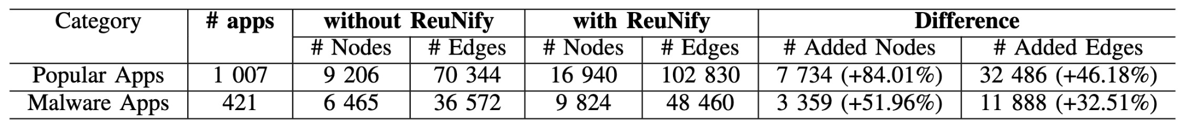
Evaluation - RQ1 How well does REUNIFY enhance Soot-based static analysis on React Native Android Apps?
Average Number of Volume of Code
AVERAGE NUMBERS OF NODES AND EDGES BEFORE AND AFTER REUNIFY ON 1,007 MOST POPULAR APPS AND 421 MALWARE APPS

Slide 20
Evaluation - RQ1 How well does REUNIFY enhance Soot-based static analysis on React Native Android Apps?
Soot tends to miss a significant portion of executable code when analyzing React Native Android Apps
With ReuNify,
70% increase for LOC for popular apps. (Java and JavaScript)
84% increase for nodes of call-graph for popular apps. (Java)
52% increase for nodes of call-graph for malware. (Java)
46% increase for edges of call-graph for popular apps (Java)
33% increase for edges of call-graph for malware.(Java)

Slide 21
Evaluation - RQ2 How effective is REUNIFY in finding sensitive data leaks in React Native Android Apps?
ReuNify is effective for identifying data leaks that were previously unseen.
On average, an additional 2 privacy leaks for both malware and popular apps.
2,690 (4,892 − 2,202) additional privacy leaks for 1,007 popular apps.
827 (3,576 − 2,749) additional privacy leaks for 421 malware apps.

Slide 22
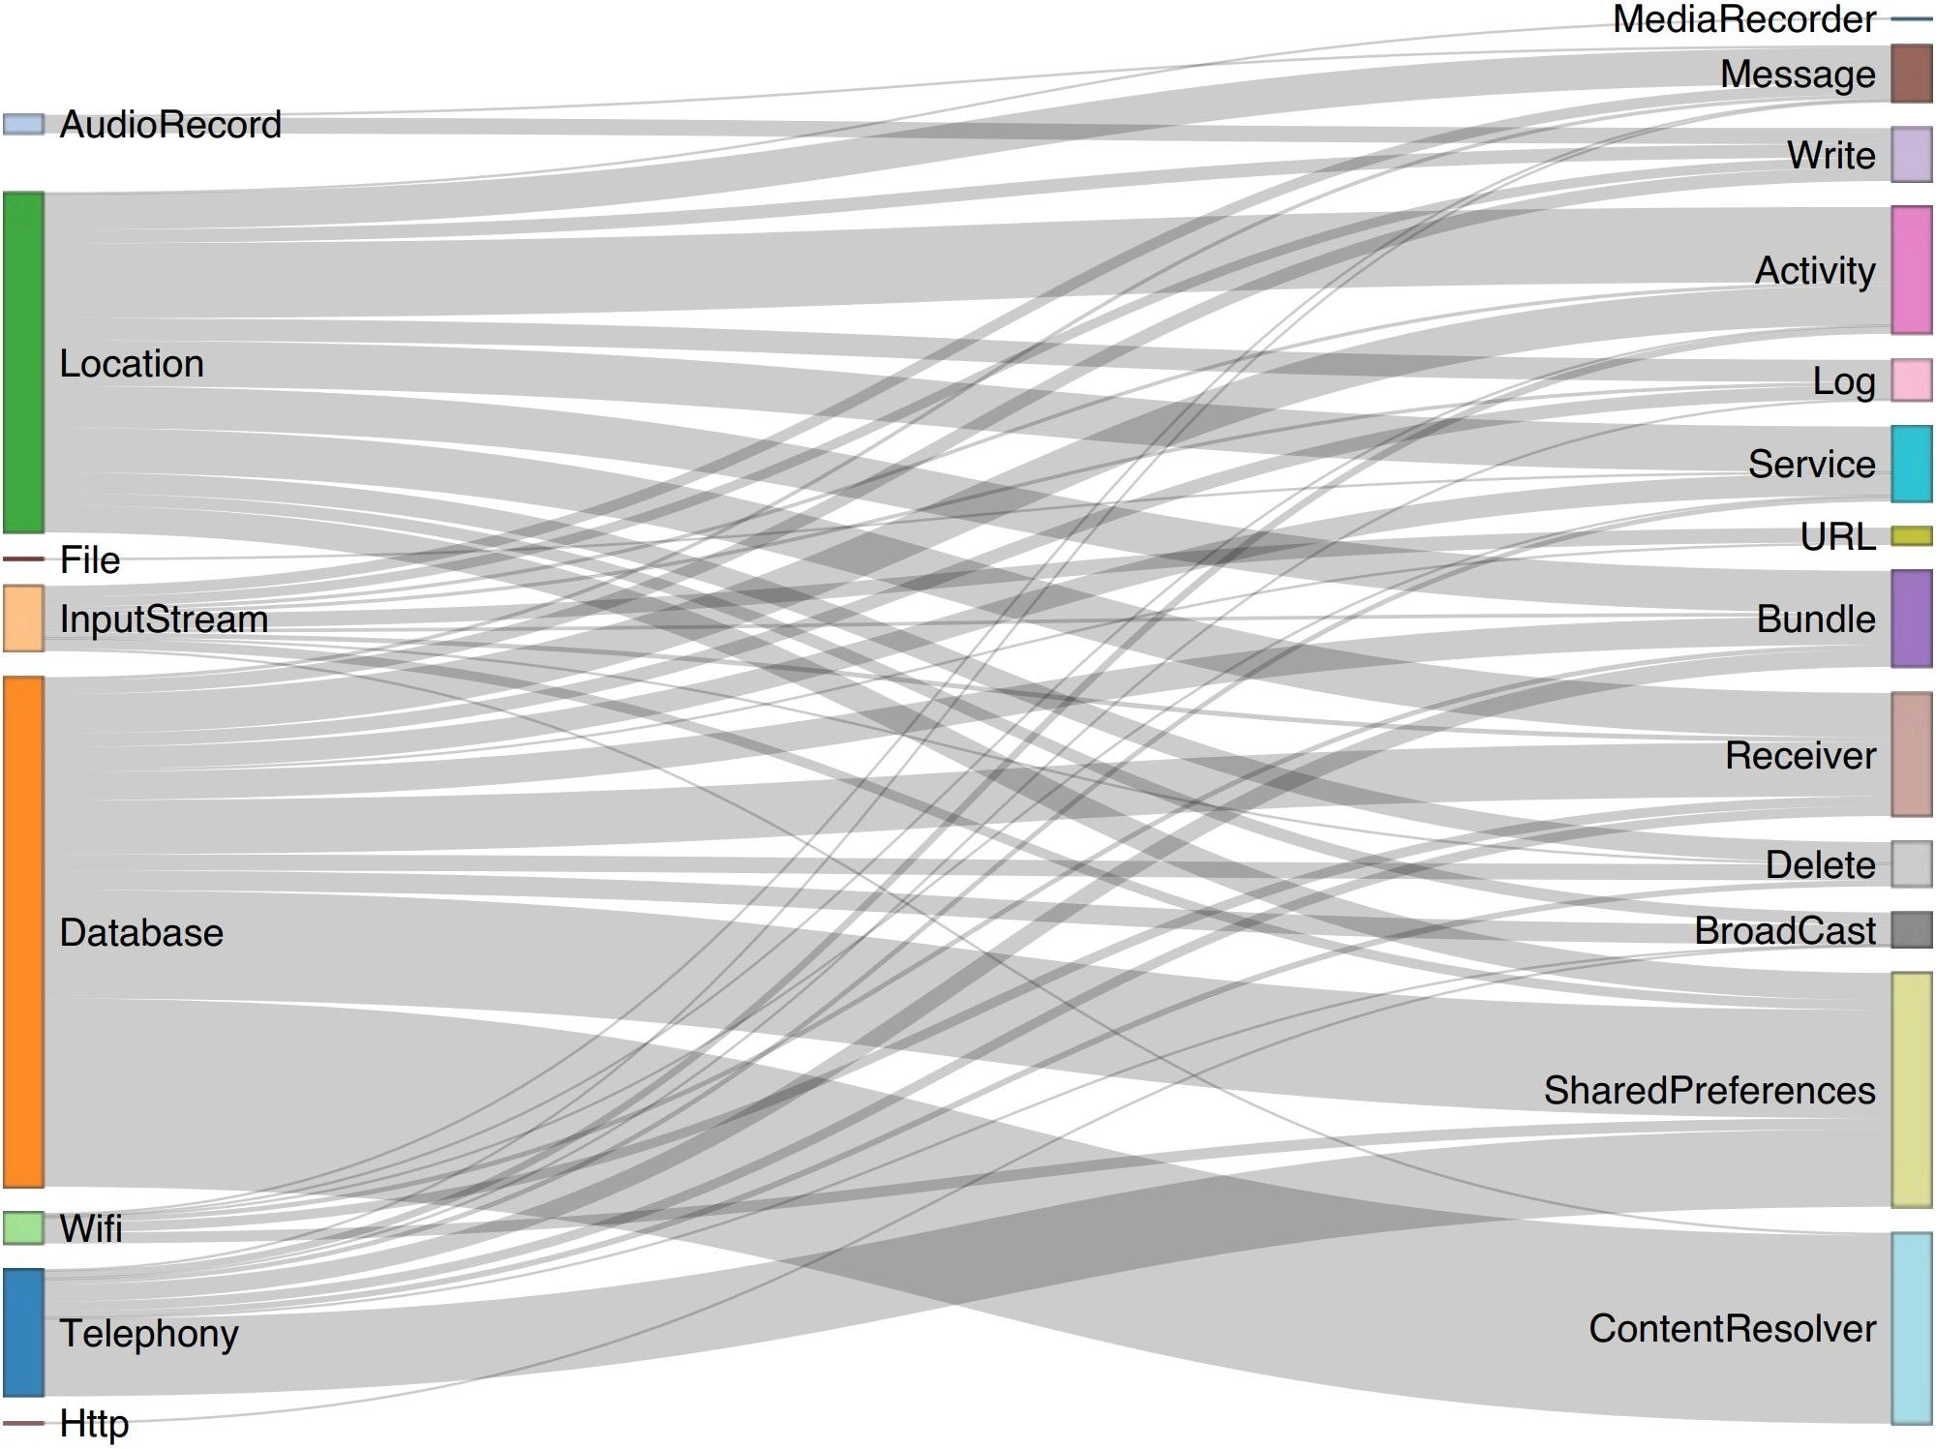
Evaluation - RQ2 How effective is REUNIFY in finding sensitive data leaks in React Native Android Apps?
Among those 3,517 (2,690 + 827) leaks:
Database, Wifi-related are the top two popular sources for popular apps
Database, Telephony-related are the top two popular sources for malware.
“replace” sink is the most detected sinks (50%).
The right side diagram excludes the paths that are leaked through “Replace” sink.
Sankey diagram of all newly detected privacy leaks.

Slide 23
Conclusion
A unified model for the code in React Native Android app.
Demonstrate the effectiveness of ReuNify.
ReuNify is publicly available at:
https://github.com/DannyGooo/ReuNify

Slide 24
Q & A
Yonhui Liu | Yonghui.Liu@monash.edu | https://github.com/DannyGooo/ReuNify

